Slide 1



Severe Flooding in Small Villages
Course:
ADTA 5240 - Harvesting, Storing, and Retrieving Data
Nonprofit Organization:
Village Resilience Initiative Team Members: Arjun Palaniswamy Kaushikan Dinakaran Rohith Singh Thakur Usha Aavula Sparsha Dandganhalli Prakash Anusha Pottipogu

Slide 2
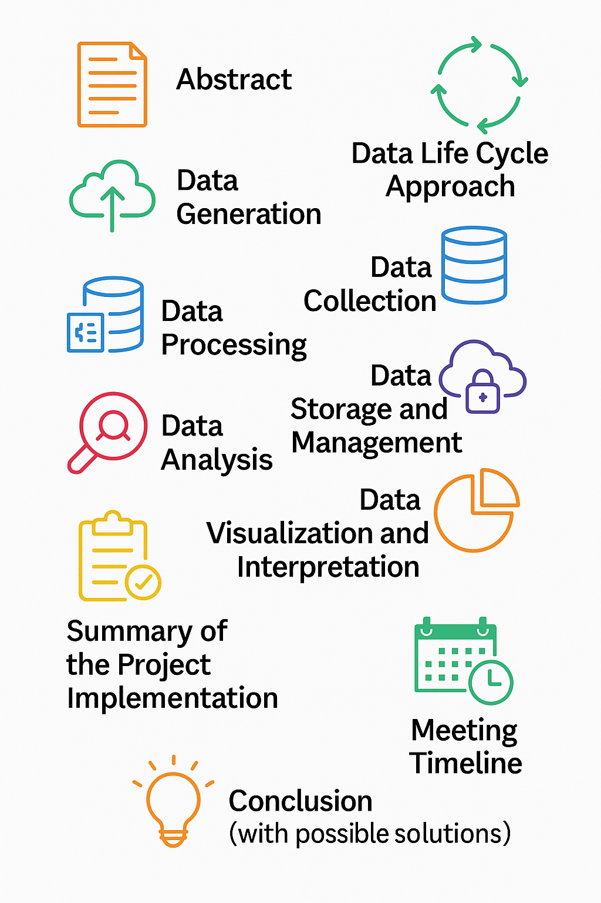
Agenda
Infographic created using OpenAI's ChatGPT and DALL-E on April 28, 2025.

Slide 3
Abstract
Develop a cloud-based data platform for the Village Resilience Initiative to predict, monitor, and respond to village-level floods.
Used GCP (BigQuery, Hive, Spark) for data management.
Static and dynamic datasets processed and analyzed.
Looker Studio used for visualization.
Future: Predictive models, early-warning dashboards.

Slide 4
Data Life Cycle
Generation: Sourced static (NOAA) and dynamic (APIs) datasets.
Collection: Merged NOAA data; automated API requests for weather/elevation.
Processing: Cleaned data using OpenRefine; enriched with dynamic data.
Storage: Stored in Google Cloud Storage (GCS) buckets.
Management: Organized in BigQuery and Hive tables; ensured data security.
Analysis: Queried using BigQuery, Hive, Spark for insights.
Visualization: Created interactive dashboards in Looker Studio.
Interpretation: Identified high-risk areas and trends for disaster preparedness.

Slide 5
Data Sources
Static Data: Source: NOAA Storm Events Database (Texas floods, 2010–2024). Records: 5,079 flood events. Details: Property damage, fatalities, event dates, and locations.
Dynamic Data: Source: OpenWeatherMap API (temperature, rainfall, wind speed). Source: Open-Elevation API (elevation data). Purpose: Enhance flood risk assessment with real-time environmental data.

Slide 6
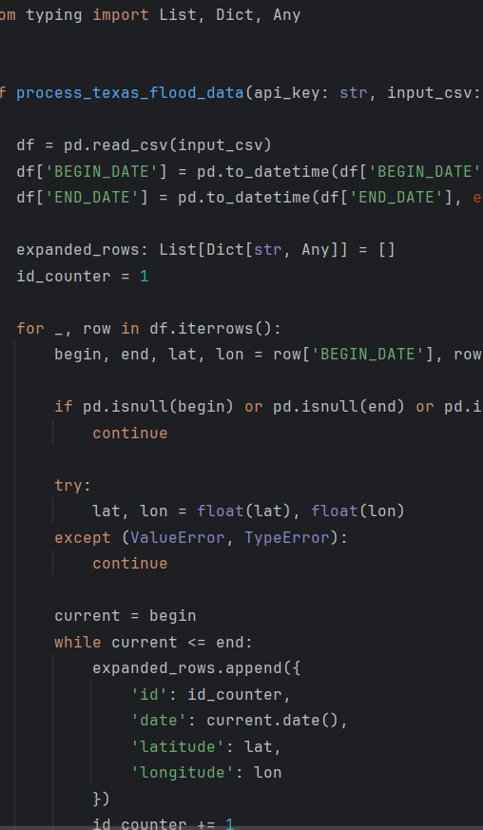
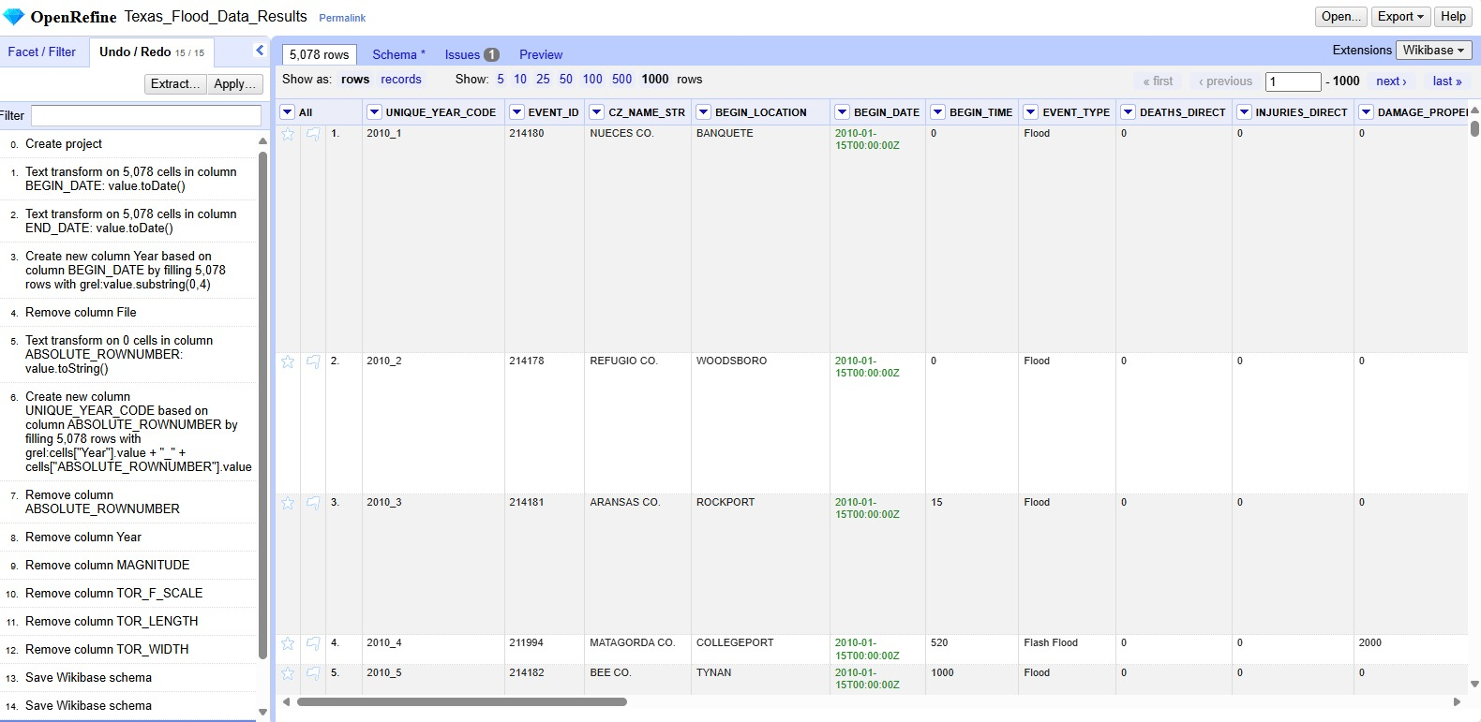
Data Processing
1) Cleaned static data in OpenRefine (removed irrelevant columns). 2) Enriched with weather and elevation data via Python scripts. 3) Standardized date formats for analysis.

Slide 7
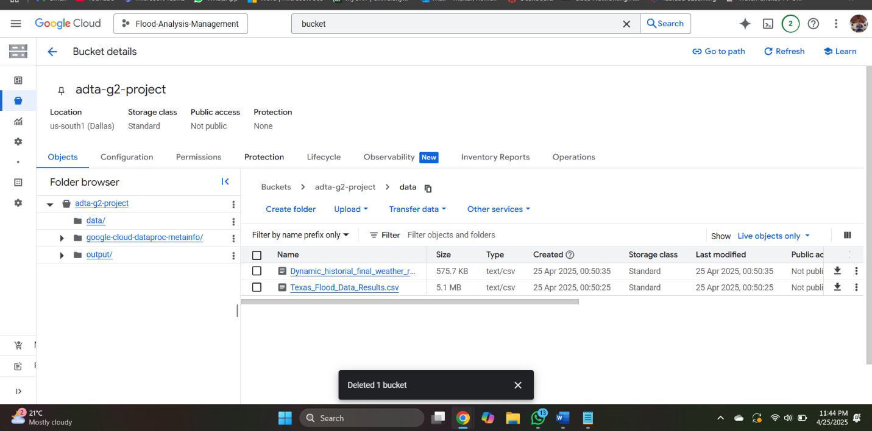
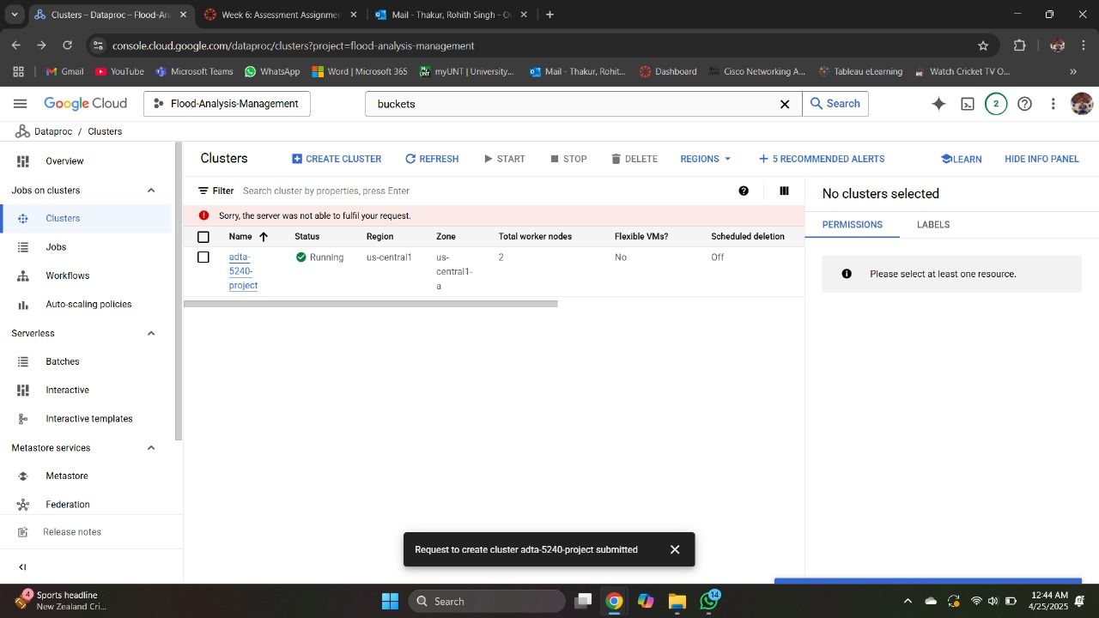
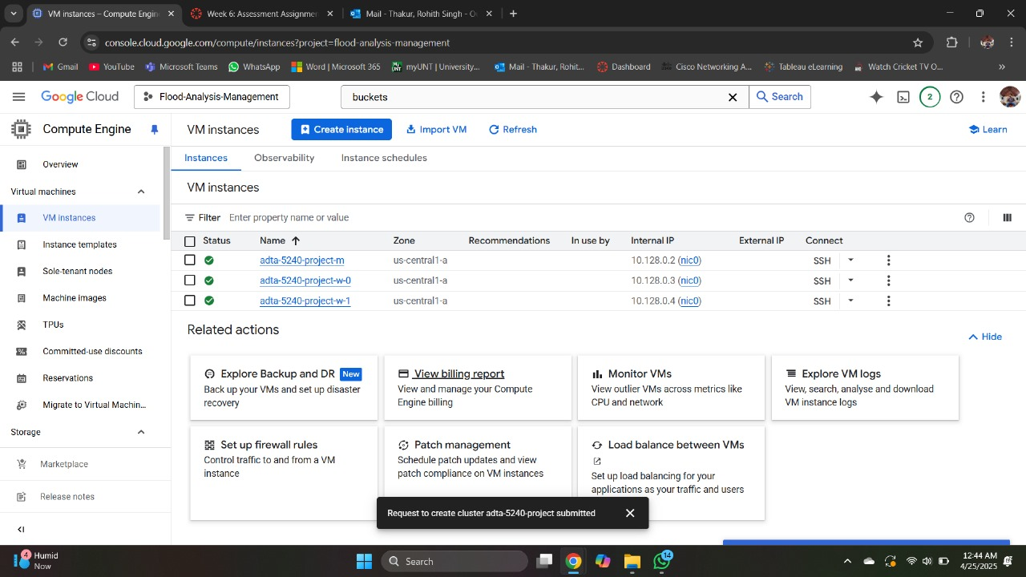
Data Storage & Management
Created GCP project: Flood Analysis and Management.
Used GCS buckets for NOAA, weather, and elevation data.
Cluster Creation: Region US Central, Total work nodes 2
VM Instance

Slide 8

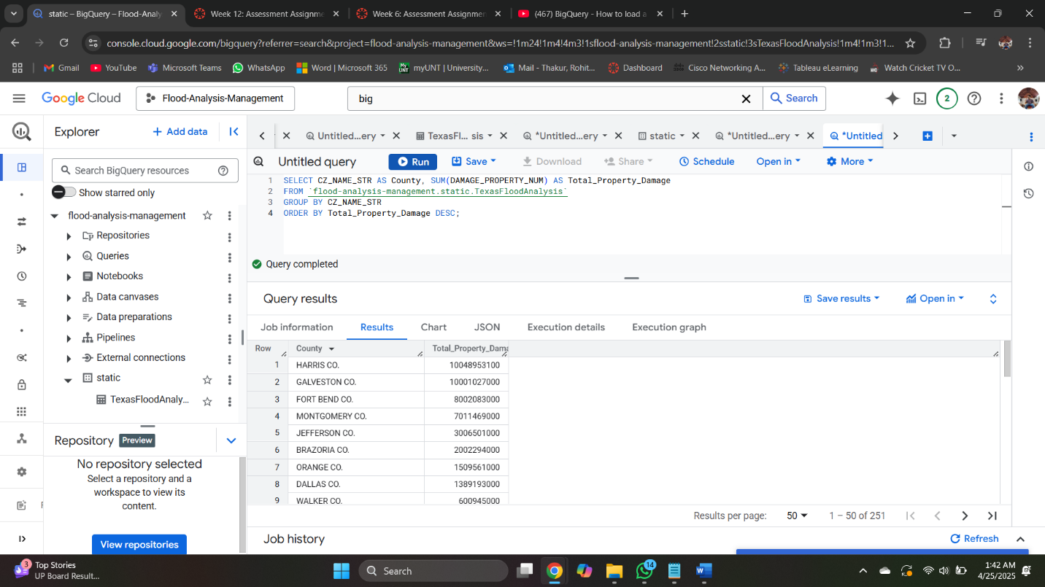
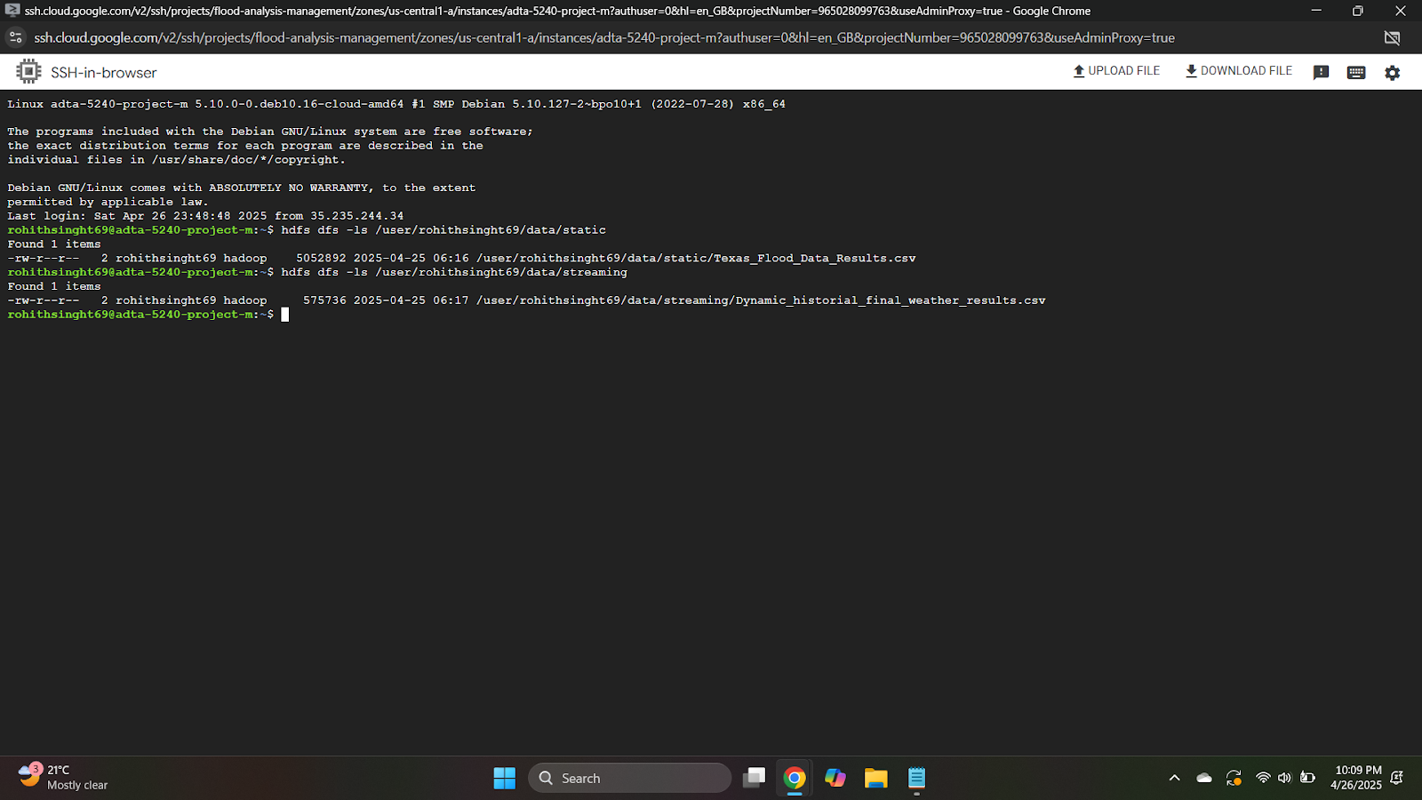
Data Analysis
Tools: 1) Big Query: SQL-based querying for static/dynamic data. 2) Hive: Large-scale querying with SQL-like structure. 3) Spark: Fast, distributed computing for streaming data.

Slide 9
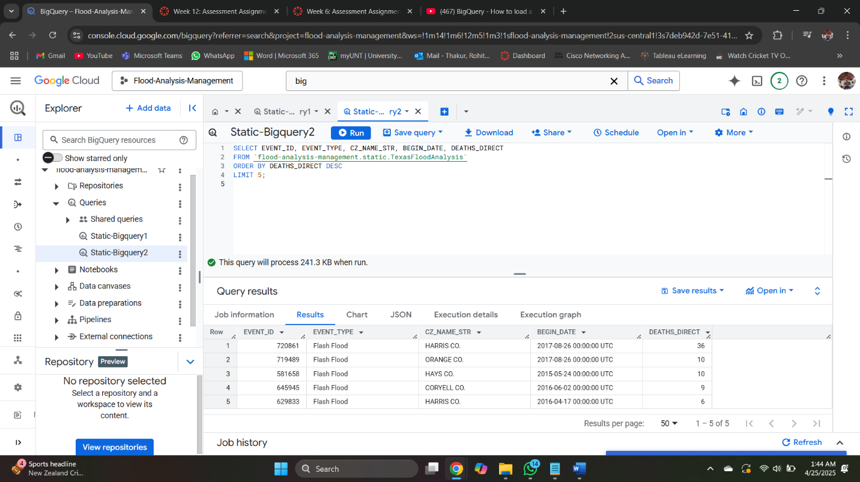
Static Data Queries:
1) Total property damage by county.
2) Top 5 deadliest floods by fatalities.
3) Annual flood event frequency

Slide 10
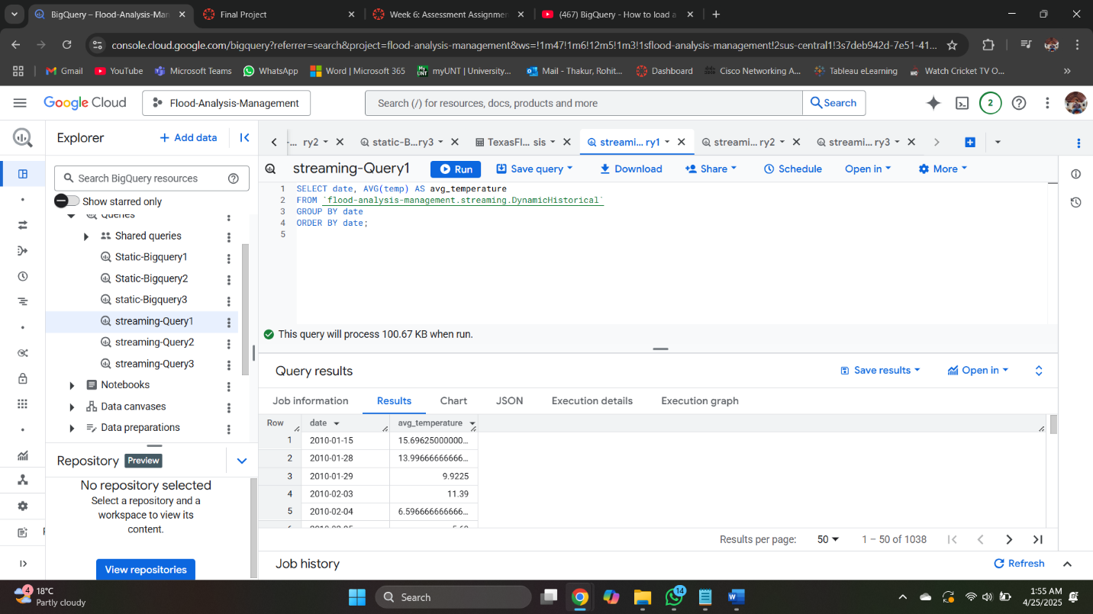
Streaming Data Queries:
1) Average daily temperatures. 2) Maximum wind speeds by location.

Slide 11
Comparison of Hive vs. Spark
 | Hive (seconds) | Spark (seconds)
Query 1 (Static Data) | 32.525 | 11.302
Query 2 (Static Data) | 7.285 | 1.113
Query 1 (Streaming Data) | 15.445 | 1.722
Query 2 (Streaming Data) | 15.11 | 2.218
Observation: Spark is faster but costlier; Hive is cost-effective for nonprofits like Village Resilience Initiative.

Slide 12
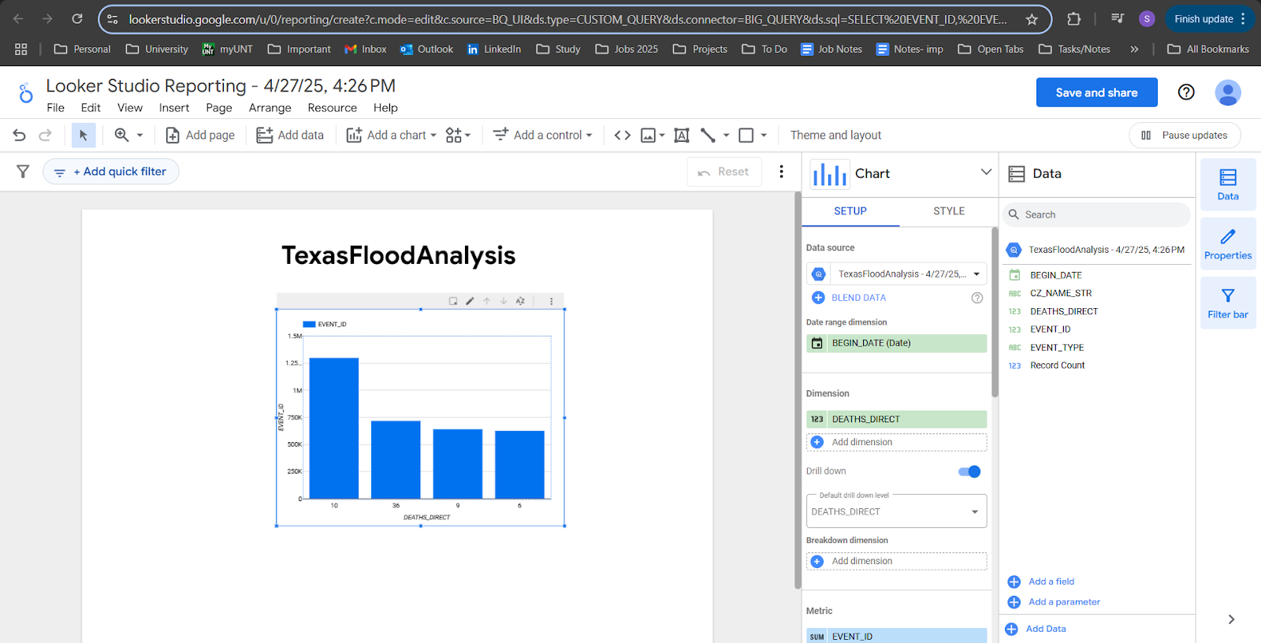
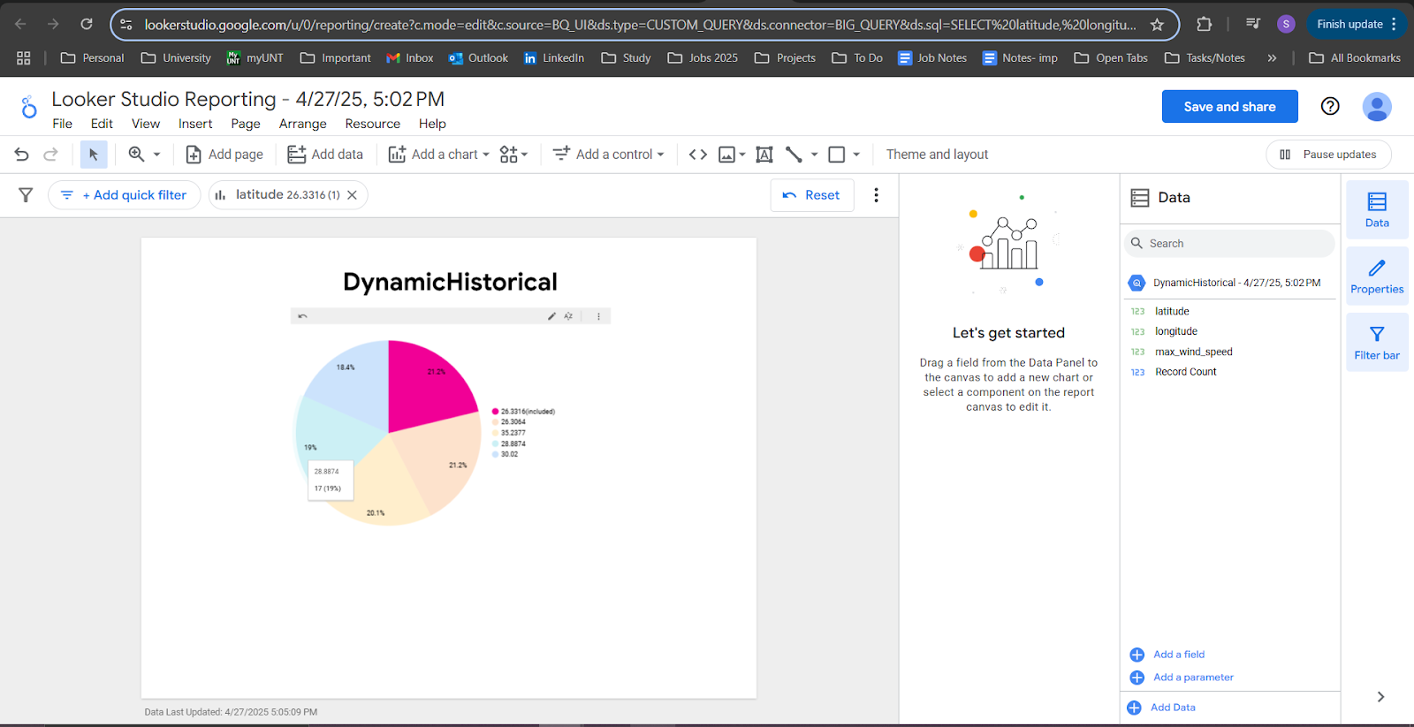
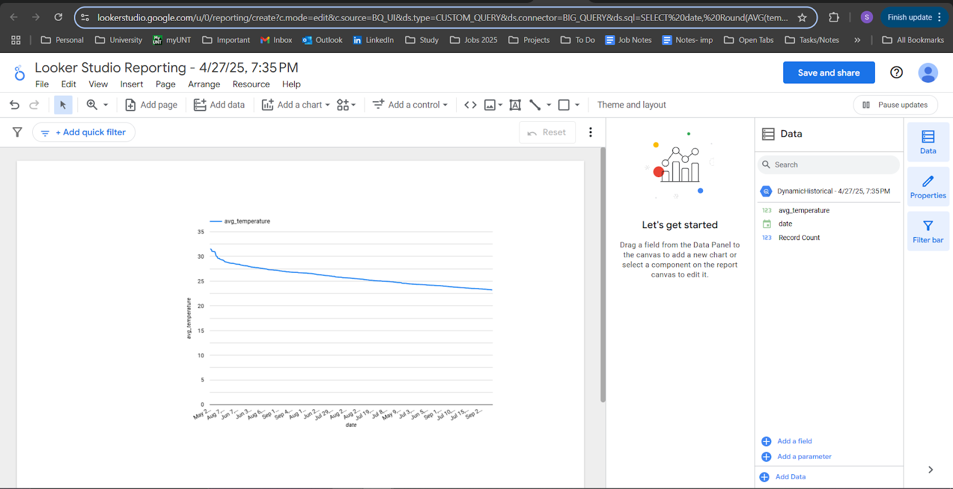
Visualizations (Looker Studio)
BONUS Implementation
Static Data: 1) County-wise Property Damage: Harris and Galveston counties faced over $10B in damages. 2) Deadliest Floods: August 26, 2017 (Harris County, 36 deaths). 3) Annual Flood Trends: Peaks in 2015, 2016, 2018, 2021, 2024 (~500 events).
Streaming Data: 1) Avg Daily Temperature: Stable trends, critical for storm pattern monitoring. 2) Max Wind Speeds: High-risk locations (e.g., latitudes 26.3316°, 26.3064°). 3) Purpose: Highlight risk zones for resource allocation and preparedness.

Slide 13
Interpretation Insights
BONUS Implementation
High-Risk Areas: Harris, Galveston, Fort Bend, and Montgomery counties.
Deadly Events: 2017 Harris County flood (36 deaths) underscores need for emergency planning.
Flood Frequency: Increased events in 2015–2021, 2024; lower in 2022–2023.
Environmental Factors: Temperature and wind speed trends aid real-time risk assessment.
Cost Efficiency: Hive chosen for cost-effective analytics for nonprofit.

Slide 14

Project Implementation
GCP Setup: Centralized project for data and resource management.
Data Enrichment: Integrated weather and elevation data for precise risk analysis.
Cross-Validation: Used BigQuery, Hive, Spark for robust results.
Visualization: Looker Studio dashboards for stakeholder communication.
Future Scope: Predictive models and early-warning dashboards.

Slide 15

Meeting Timeline
15 Apr.
Defined goals, selected datasets, created GCP project.
22 Apr.
Reviewed data, cleaned with OpenRefine, planned BigQuery load.
25 Apr.
Designed and executed queries (BigQuery, Hive, Spark).
26 Apr.
Built visualizations in Looker Studio, started documentation.
28 Apr.
Finalized report, slides, and rehearsed presentation.

Slide 16

Conclusion
Achievement: Built a scalable cloud platform for flood data analysis.
Impact: Delivered actionable insights to improve disaster preparedness.
Tools Leveraged: BigQuery, Hive, Spark, OpenRefine, Looker Studio.
Possible Solutions: Flood Vulnerability Mapping; Real-Time Community Alerts; Infrastructure Risk Assessment; Proactive Resource Distribution
Future Potential: Real-time alerts, predictive modeling for enhanced resilience.

Slide 17
References
[1] Google Cloud. (n.d.). BigQuery Documentation. Google Cloud. Retrieved April 27, 2025, from https://cloud.google.com/bigquery/docs
[2] Apache Software Foundation. (n.d.). Apache Hive Documentation. Retrieved April 27, 2025, from https://hive.apache.org/
[3] Apache Software Foundation. (n.d.). Apache Spark Documentation. Retrieved April 27, 2025, from https://spark.apache.org/docs/latest/
[4] OpenRefine. (n.d.). OpenRefine: A free, open source, powerful tool for working with messy data. Retrieved April 27, 2025, from https://openrefine.org/
[5] Google Cloud. (n.d.). Looker Studio Help. Retrieved April 27, 2025, from https://support.google.com/looker-studio/
[6] NOAA National Centers for Environmental Information. (n.d.). Storm Events Database. Retrieved April 27, 2025, from https://www.ncdc.noaa.gov/stormevents/
[7] OpenWeather. (n.d.). OpenWeatherMap API Documentation. Retrieved April 27, 2025, from https://openweathermap.org/api
[8] Open-Elevation. (n.d.). Open-Elevation API. Retrieved April 27, 2025, from https://open-elevation.com/

Slide 18

Thank You …

